Slide 1
2500 5th Ave Seattle 98121
(206) 397-0097

Slide 2
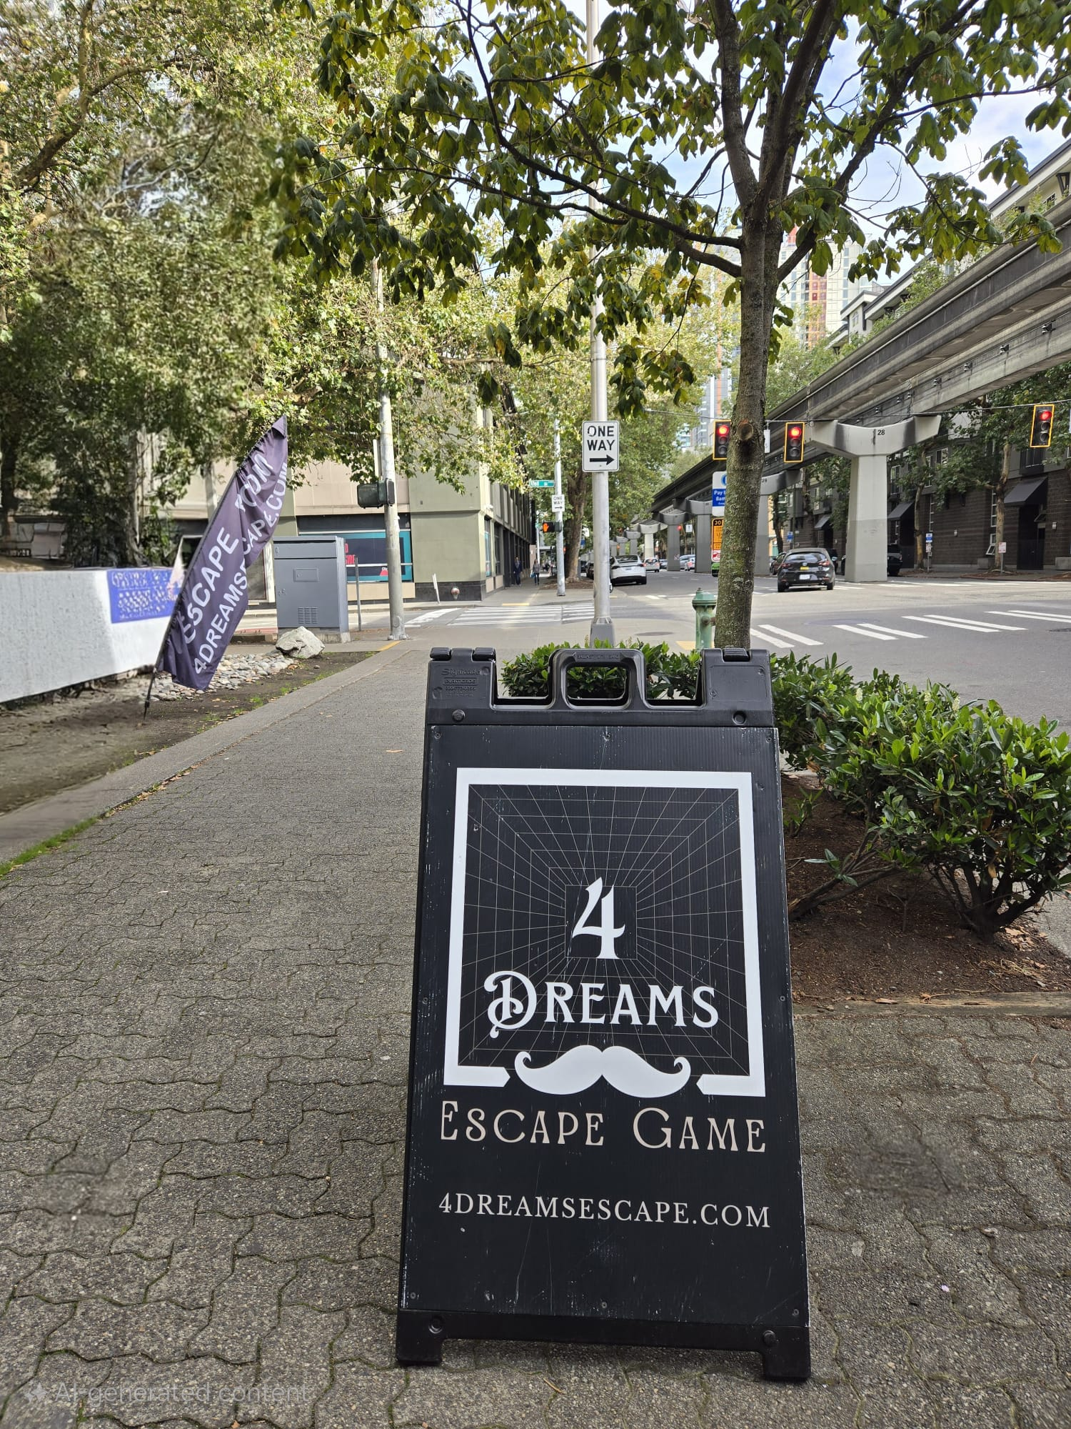
About 4 Dreams Escape Room
Established in Feb 2024, 4 Dreams is one of the newest Escape Rooms in Seattle. We built this room with unique design which allows gamers to experience 4 “Dream” rooms in single session. Each room has 4 puzzles so you will enjoy solving 16 unique puzzles! The puzzles are designed to be solved as a team. We are expanding to new locations on the East side in Spring 2025!
4 Dreams is owned by a Seattle Tech Executive who is passionate in providing fun and bonding experience to the Corporate customers!

Slide 3
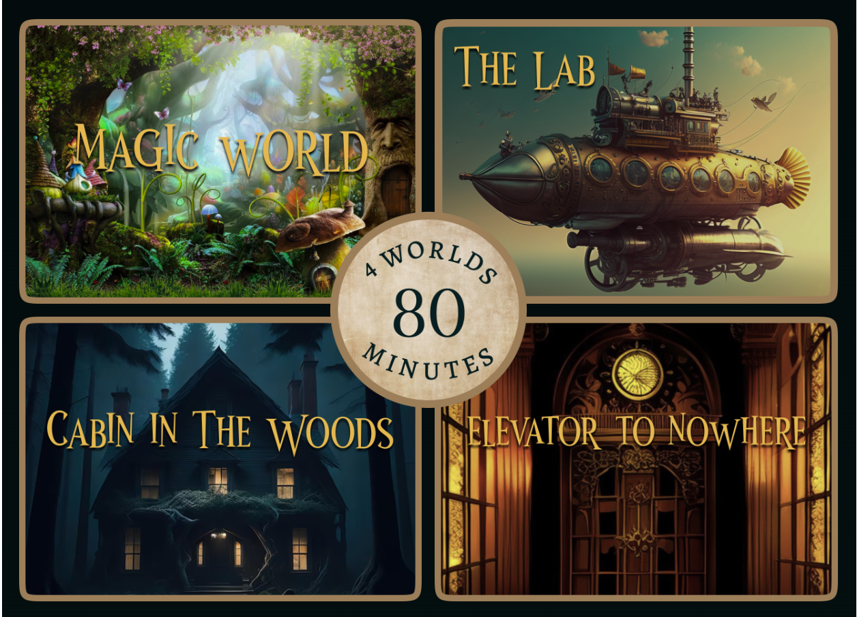

Slide 4
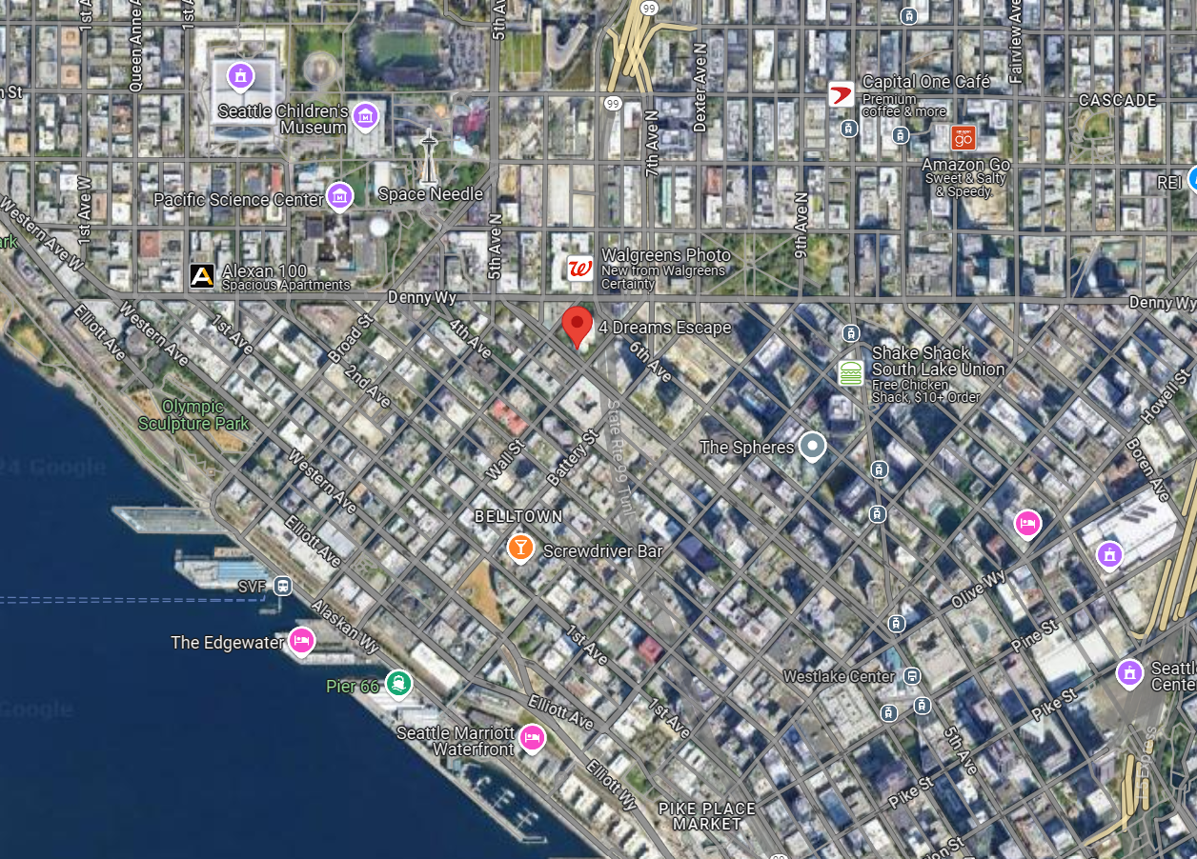
Where to find us?
We are in the Belltown area in Seattle on the 5th ave. We are perfectly located near Space Needle, Pacific Science Center, Pier, Pike Place market, West Lake Mall. There is so much to do and see around! Plan you day to eat near by and spend an hour or so experiencing our Escape Room!
For the East side folks, we can arrange rides for your team!
2500 5th Ave Seattle 98121
206-397-0097

Slide 5
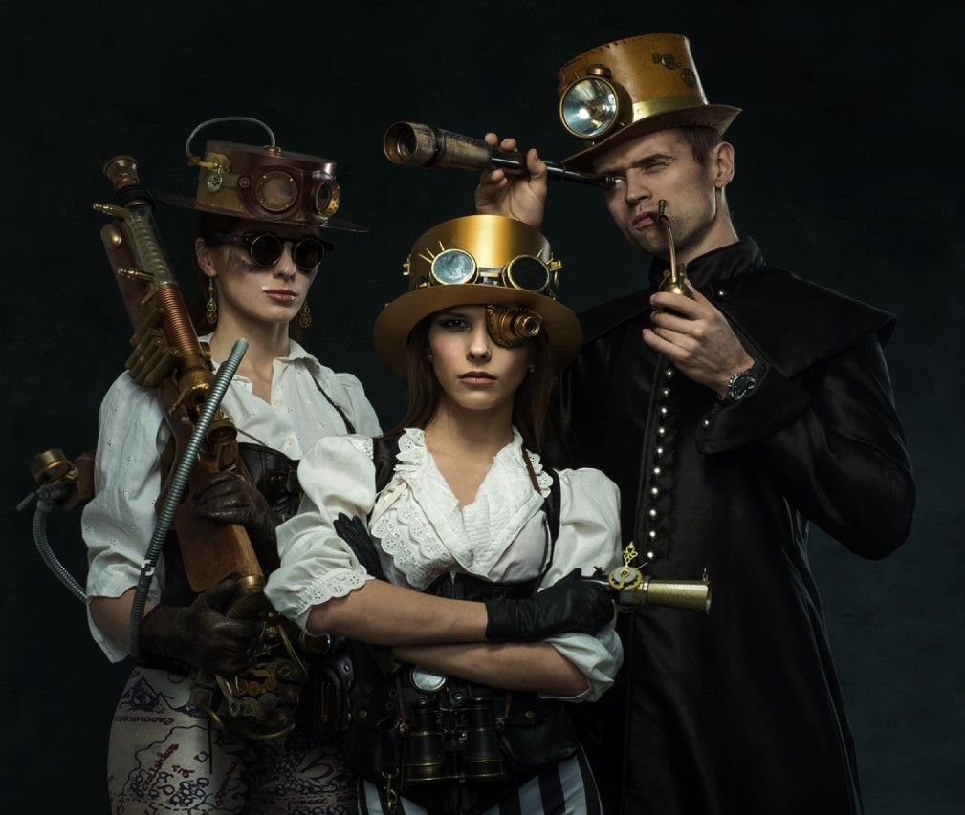
What do we offer?
Team Building – work as a team to solve the puzzles
Race against time – Solve puzzles within 20 mins in each of the 4 rooms
Race against each other – Team that solves all puzzles and escapes, wins a prize!
Free memorabilia for all players!
Photobooth to take pictures
Feature on our Facebook and Instagram
Additional board games and puzzles
Additional Services for extra cost
Food, Snacks and Drinks
Custom decoration/setup
Gifts – T-shirts, coffee mugs, hats, small puzzles

Slide 6
What are our prices?
For discounted $39 per person (minimum 10 players for reservation)
Entire location reserved for
2 hours for 10-20 players, or
3 hours for up to 30 players
Additional Services
We partner with a catering company which provides boxed lunch for $17.95 - $19.95/box.
Boxes Sandwiches (veg and non-veg options), chips, cookie/brownie
Veg/Non-veg Pasta or Pasta salad, chips, cookie/brownie
Caesar Salad or Mixed Greens Salad and chips, cookie/brownie
Holiday Gifts: You can add holiday gifts for additional $10-$15 per gift. These include small puzzles, coffee mugs, hats, 4Dreams T-shirts
Custom decoration for the event. Cost varies

Slide 7
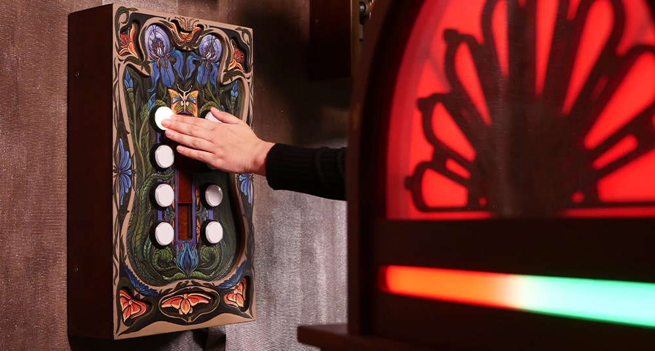
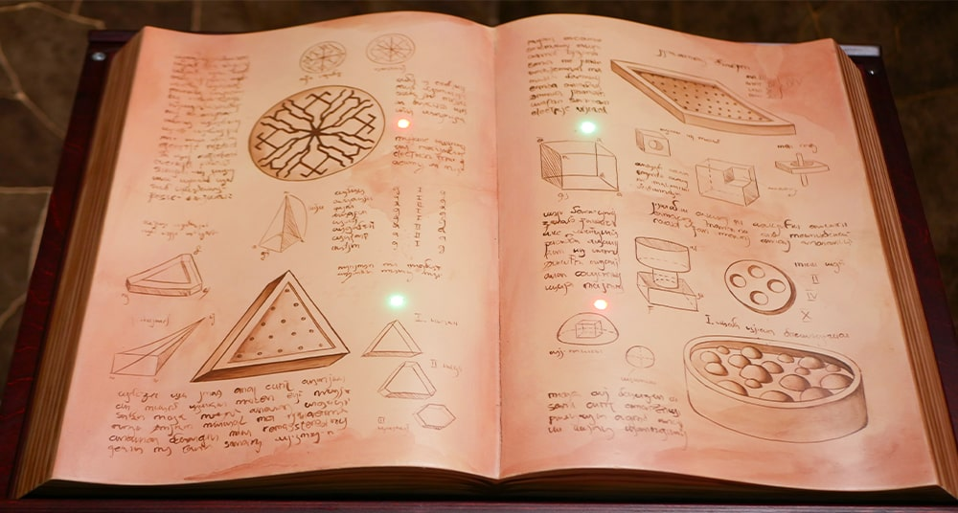
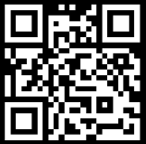
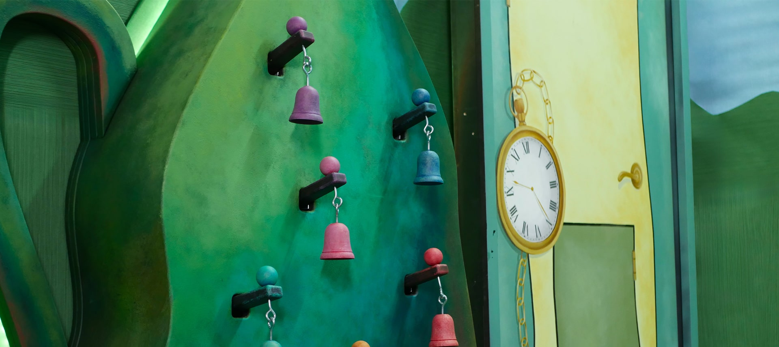
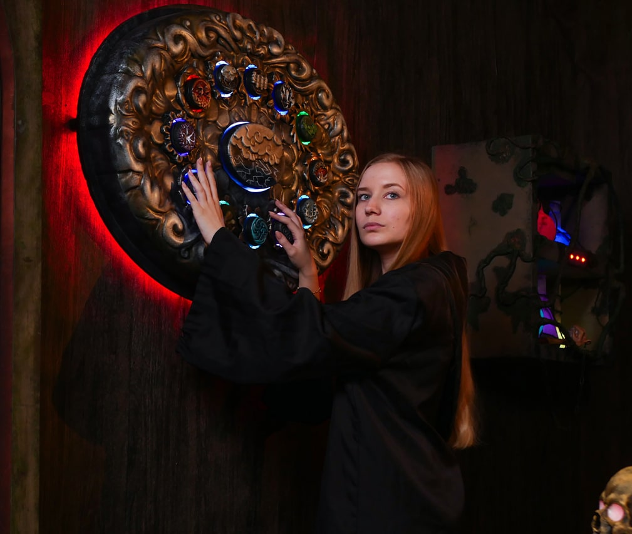
How to Contact?
Website: http://4DreamsEscape.com
Phone: (206) 397-0097
Email: Seattle4Dreams@gmail.com
@4DreamsEscape

